Slide 1





Assignment-2 (Part-2)
Advancing Scientific Discoveries using NumPy and SciPy
Ajay Choudhury (18018)
EECS Department
IISERB

Slide 2


Introduction
Python is one of the most important tools in every scientist’s toolbox that comes in handy in every field of his/her research.
Python being very easy to understand and having a low learning curve is user-friendly and easily adaptable which in turn has led to its huge popularity.
Being popular and carrying thousands and thousands of useful libraries and packages, it is now an indispensable language in any field, from market analysis to space probes, Python has got its feet down efficiently.

Slide 3

NumPy and SciPy lie at the core of all the scientific modules available in Python. They have gradually become the standards for scientific implementation in Python.
Implementation of NumPy using C programming language which makes it very fast and efficient in terms of memory. These are some of the prime reasons it has risen to be the standard in scientific-computing ecosystem.
Various standard libraries like Matplotlib, Pandas, Scikit-Learn and Scikit-Image use NumPy in their core.

Slide 4
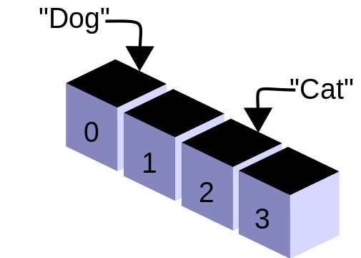

Analysis of NumPy
Comparing NumPy with Lists in Python
There are two basic factors upon which NumPy can be compared with Python's native Lists.
Speed
Memory consumption
We can further compare the speed of NumPy with that of Lists using the time module in Python and can get a graph of it as an illustration.

Slide 5
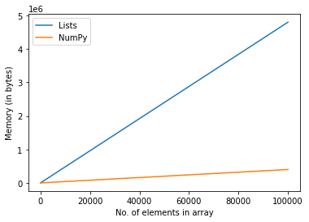
Comparison of Memory consumption
Native Lists in Python
Lists consume considerably more memory than NumPy.
NumPy is more efficient than Lists
NumPy has a more efficient method to store data and occupies much lower space than lists.

Slide 6
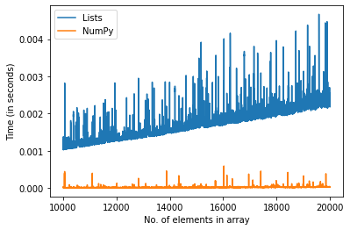
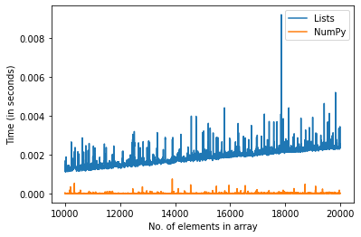
Comparison of Speed of Operations
Lists in Python are comparatively slower in performing basic operations than NumPy. Here are a few illustrations to justify the fact:
Sum Operation
Multiplication

Slide 7
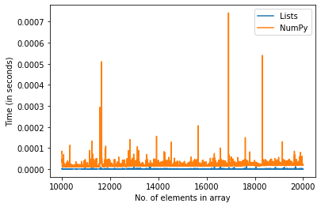
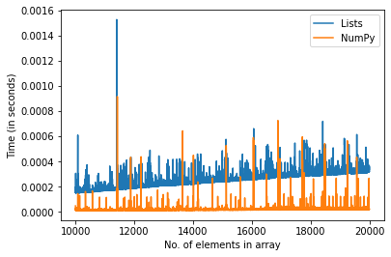
Comparison of Speed of Operations
Appending
Searching

Slide 8
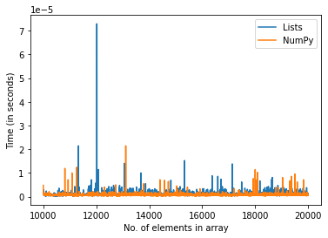
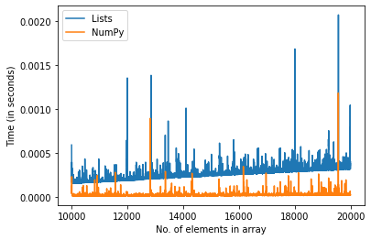
Comparison of Speed of Operations
Updation
Deletion

Slide 9

Unlike lists, NumPy arrays can be operated using arithmetic operations and it provides an efficient implementation of arrays.
But NumPy’s append operation has a time complexity of O(n) whereas that of the list has O(1) making lists faster than NumPy arrays while appending elements.
For other tasks NumPy outperforms lists. With the development of modern data processing hardware such as GPU (Graphical Processing Unit), TPU (Tensor Processing Unit), FPGA (Field Programmable Gate Arrays). The need for NumPy to be compatible with such hardware has become essential for its sustenance in the future.

Slide 10

Discussion on SciPy
SciPy holds essential scientific algorithms and is built on top of NumPy.
It makes use of NumPy’s fast numerical routines. Several Packages are build using SciPy, Scikit-Learn and Scikit-Image to name a few.
It has implementations for image processing, statistics, machine learning, symbolic computation and network analysis.
SciPy offers a one-stop solution for basic scientific computations for example Linear Algebra related algorithms.

Slide 11
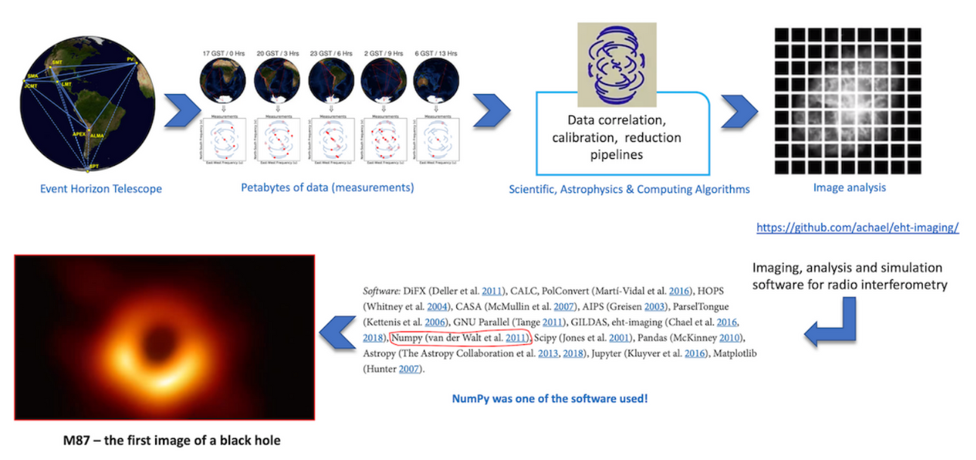
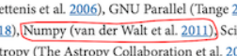
SciPy : First Image of Black hole
A large amount of data needed to be collected and decisions need to be made on which data to use and which not.
Those pipelines were built on pandas and SciPy, the standard astronomical file formats and time transformations were handled by Astropy.
For plotting matplotlib module was used. All of these modules are built upon NumPy’s arrays.

Slide 12

Conclusion
Interactive programming practices such as IPython and Jupyter Notebook has enabled further growth of python.
The emergence of GitHub and has accelerated the development of open-source packages such as NumPy and SciPy.
Its role towards accelerating scientific research is unquestionable, but to be sustainable in the future it will need to accommodate modern hardware architectures such as GPU and TPU.

Slide 13

The Scientific community focused on numerical computing have long neglected python due to its lack of speed, with the advent of Numba and further improvements in speed shall make python more favourable to the numerical computing community

Slide 14



References
01. Array programming with NumPy. Nature, 585:357–362, 2020.
02. Fundamental Algorithms for Scientific Computing in Python. Nature Methods, 17:261–272, 2020.

